Slide 1
BIG DATA PROJECT | MIDTERM PRESENTATION
US Accidents
Big Data Analysis
Dataset Overview · Tools & Environment · EDA Insights
Group Members: Mansi Deshmukh, Md. Faiq Salman, Sanjay Bharvad, Sharan Patil

Slide 2
Background and Motivation
Large scale data can help identify hidden pattens and risk factors.
Big data tools enable efficient analysis of millions of record.
Focus: Understanding trends by time, location. severity
7.7M
46+
7yr
49
Records
Features
Span
States

Slide 3



Dataset Overview & Motivation
Source
Why This Qualifies as Big Data
Kaggle – Sobhan Moosavi
API + Gov + Sensor + Camera data
Volume
7.7M records exceed Excel limits.
Requires Spark for efficient processing.
Coverage
Variety
Mixed types: numerical, categorical,
temporal, and geospatial features.
Feb 2016 – Mar 2023
49 US States, 7.7M accident records
Features
More than 46 attributes: weather, time,
geospatial, road, severity (1–4)

Slide 4
System Pipeline & Tools
Raw CSV
Input
HDFS
Storage
Spark
Processing
EDA &
ML Model
Tableau
Dashboard
7.7M rows
46 cols
Distributed
File System
Clean &
Transform
Python /
MLlib
Visual
Output
TOOLS USED
Apache Spark
HDFS / Hadoop
Python / Pandas
Distributed processing & ML
Distributed file storage
EDA & feature engineering
Spark MLlib
Tableau
Jupyter / Colab
Classification model training
Interactive dashboard
Dev environment

Slide 5
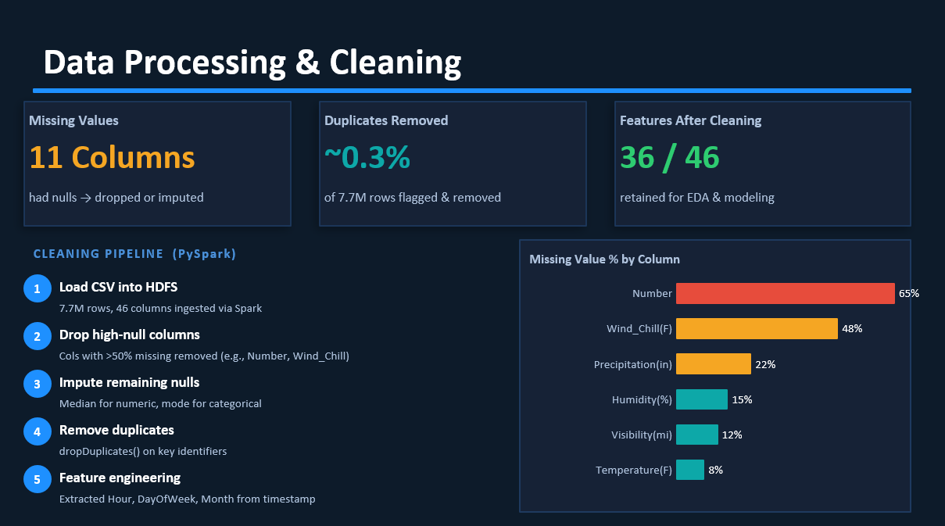

Slide 6
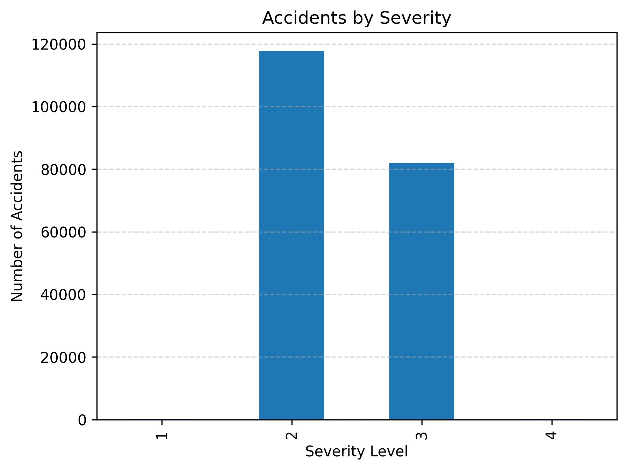
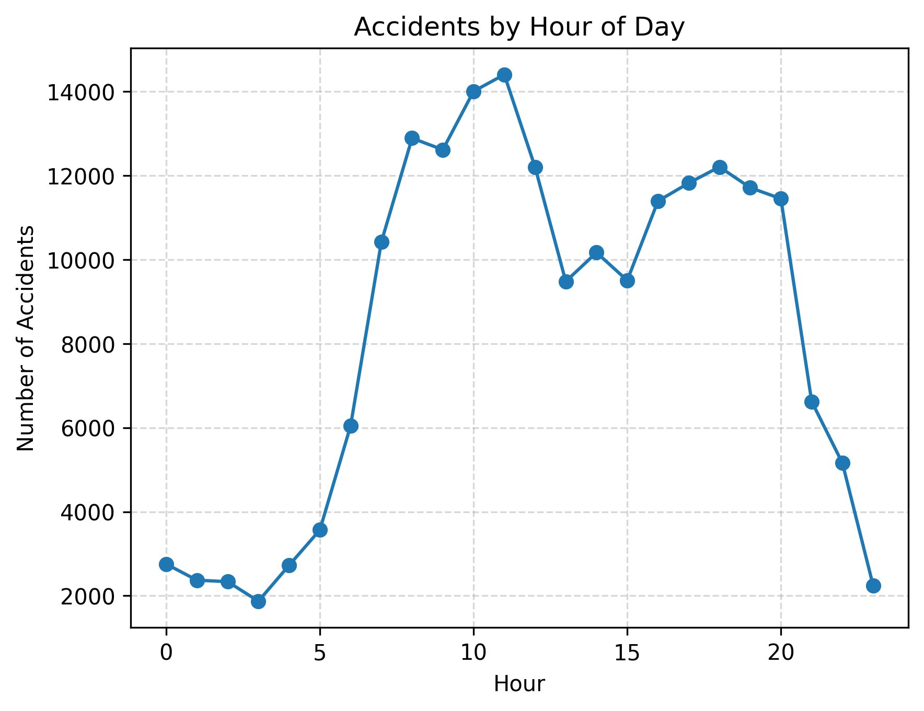
EDA Insights — Severity & Time Patterns
Accidents by Severity Level
Accidents by Hour of Day
⚠ Severity 2 dominates — major class imbalance to address in ML
⏰ Peak accidents at 10–11 AM and 4–6 PM — rush hour correlation

Slide 7
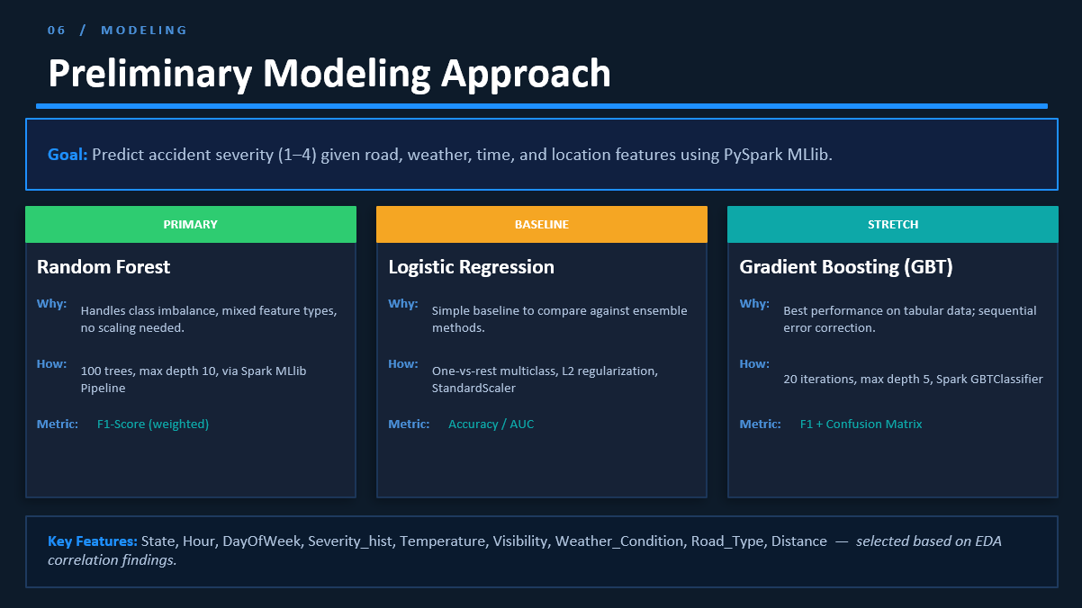

Slide 8
